Slide 1
Load station PBS - > TRIM1
Home design project
PE T&C
Kadykov Vladimir

Slide 2
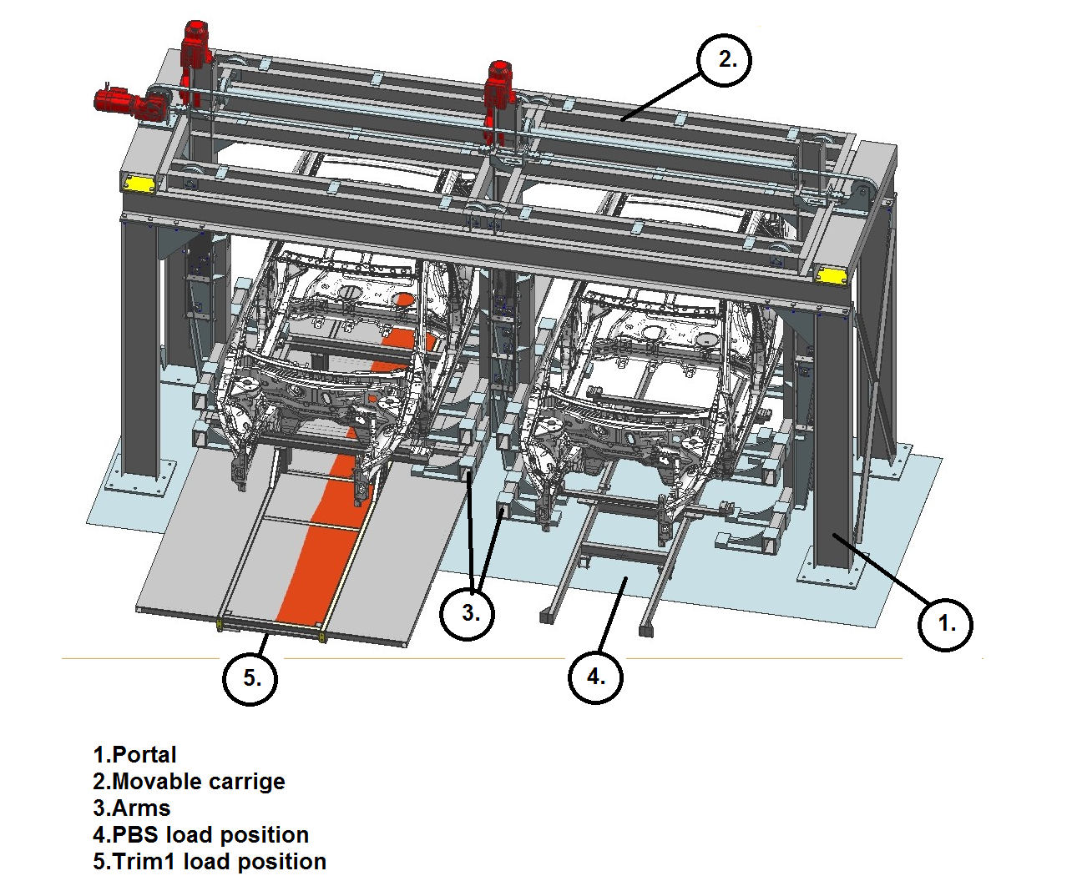
Load station design

Slide 3
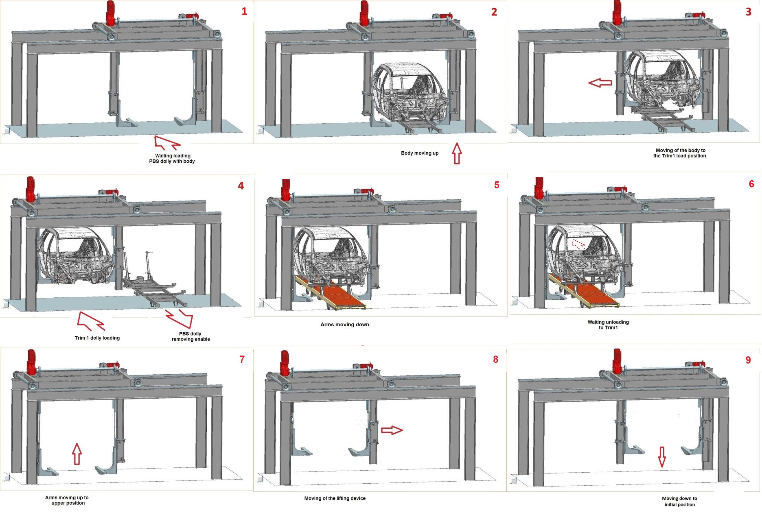
Work algorithm

Slide 4
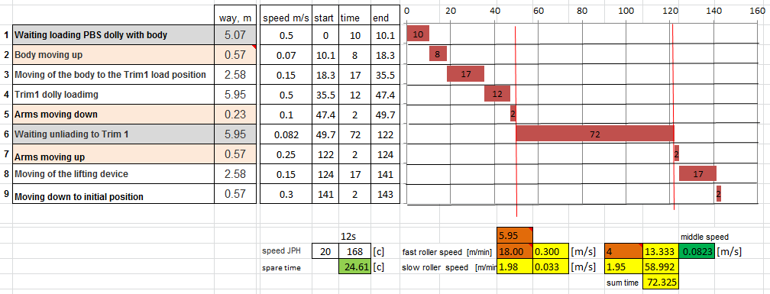
Time chart

